Slide 1
This is JEOPARDY!
I’m your host, Mrs. Willi!

Slide 2
Vocab
Areas
Apps!
Vectors
Triangles
$2
$2
$2
$2
$2
$3
$3
$3
$3
$3
$5
$5
$5
$5
$5
$10
$10
$10
$10
$10
$20
$20
$20
$20
$20

Slide 3
A quantity with both magnitude and direction.

Slide 4
What is a vector?

Slide 5
The form that results from taking the terminal point minus the initial point of a vector.

Slide 6
What is component form?

Slide 7
The term that means two vectors are perpendicular.

Slide 8
What is orthogonal?

Slide 9
The possible number of triangles that can result from using the law of sines.

Slide 10
What is 0, 1, or 2?

Slide 11
The term used to describe a non-right triangle.

Slide 12
What is oblique?

Slide 13
What s is equal to in Heron’s Formula.

Slide 14
What is half the perimeter ?

Slide 15
The area of the triangle with sides of 9, 12, and 17 inches.

Slide 16
What is 51.58 ${in}^{2}$ ?

Slide 17
The area of a triangle with A = $51°$, b = 12, and c = 8 feet.

Slide 18
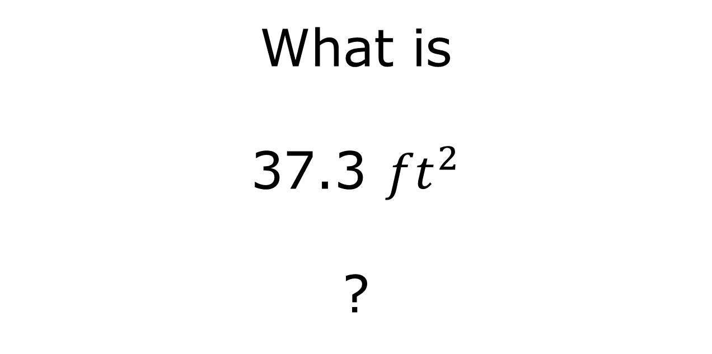
What is 37.3 ${ft}^{2}$ ?

Slide 19
The number of acres in a triangular parcel of land if the lengths of the sides measure 1702 feet, 4021 feet, and 4000 feet. 1 acre = 43,560 ${ft}^{2}$

Slide 20
What is 76.6 acres ?

Slide 21
The number of students in this class when everyone is present.

Slide 22
What is 10 – 1st hour 23 – 3rd hour 19 – 6th hour ?

Slide 23
The component form of a vector with a magnitude of 100 pounds and a direction angle of 30°.

Slide 24
What is $$\left\langle 50\sqrt{3},50\right\rangle ≈\left\langle 86.6,50\right\rangle$$ ?

Slide 25
The force required to keep a 2000 pound car from rolling down a 30° incline.

Slide 26
What is 1000 pounds ?

Slide 27
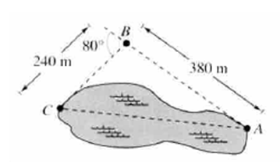
The approximate length of the pond pictured below.

Slide 28
What is 483.4 feet ?

Slide 29
The distance along the old roof that the new roof reaches.

Slide 30
What is 33.5 feet ?

Slide 31
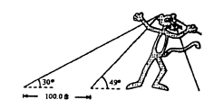
The height of the giant helium balloon pictured.

Slide 32
What is 115.9 feet ?

Slide 33
The name of the villain who invented the Piranha Gun in Despicable Me

Slide 34
Who is Vector ?

Slide 35
The vector with an initial point of $\left(5, −7\right)$ and terminal point $\left(4,6\right)$.

Slide 36
What is $$\left\langle −1,13\right\rangle$$ ?

Slide 37
The magnitude of the vector $\left\langle −10,16\right\rangle$.

Slide 38
What is $\sqrt{356}≈2\sqrt{89}≈18.87$ ?

Slide 39

$$3\vec{v}−4\vec{w}$$ given $\vec{v}=\left\langle −1,5\right\rangle$ and $\vec{w}=\left\langle 5,7\right\rangle$.

Slide 40
What is $\left\langle −23,−13\right\rangle$ ?

Slide 41
The unit vector in the same direction as $\left\langle 15,20\right\rangle$.

Slide 42
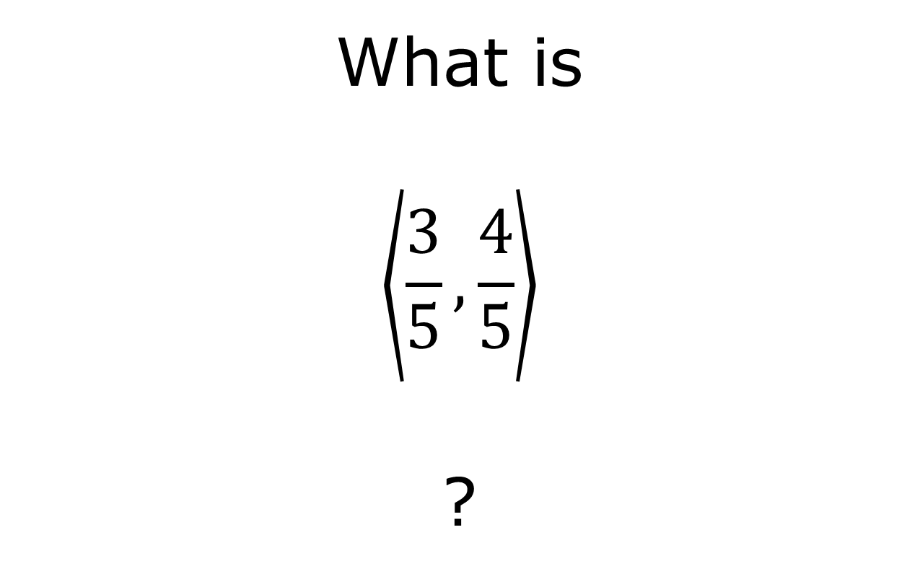
What is $$\left\langle \frac{3}{5}, \frac{4}{5}\right\rangle$$ ?

Slide 43
The length of the hypotenuse of a right triangle that has legs of 3 feet and 4 feet.

Slide 44
What is 5 feet ?

Slide 45
The length of side b given B = 87°, C = 24°, and a = 113.

Slide 46
What is 120.9 ?

Slide 47
The measure of angle C given a = 18, b = 23, and A = 97°.

Slide 48
What is 32° ?

Slide 49
The measure of angle A given a = 53, b = 94, and c = 87.

Slide 50
What is 33.8° ?

Slide 51
The two measures of angle A given B = 56°, a = 98, and b = 85.

Slide 52
What are 72.91° and 107.09° ?

Slide 53
Final Jeopardy A boat leaves a port and sails 16 miles at a bearing of S 20°E. Another boat leaves the same port and sails 12 miles at a bearing of S 60°W. How far apart are the two boats at this point?

Slide 54
Final Jeopardy Answer What is 18.26 miles?

