Slide 1
Precalculus
Unit 5 Review

Slide 2
Find a positive and a negative angle that
are co-terminal to $\frac{7π}{13}$?

Slide 3
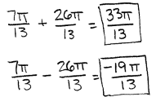

Slide 4
Convert 254° to radians. Leave your answer in terms of $π$.

Slide 6
Convert $\frac{3π}{11}$ to degrees. Round to the nearest tenth.

Slide 8
An angle of 70° intercepts an arc of
15 inches. What is the radius of the circle?

Slide 9
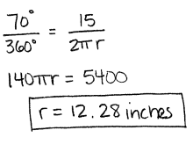

Slide 10
Find the measure of the angle $θ$that intercepts an arc of 5 feet on a circle of radius 2 feet.

Slide 11
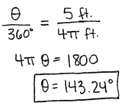

Slide 12
The $\sin\left(43°\right)=\cos\left(x°\right)$. Find the value
of x.

Slide 14
Use your unit circle to find the exact value
of each of the following.
a.) $\sin{\frac{11π}{6}}$ b.) $\csc{\frac{−14π}{3}}$ c.) $\tan{\frac{7π}{2}}$

Slide 15
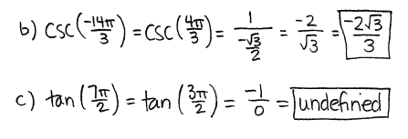

Slide 16
Given that $AB=16$ and $\cos{B}=\frac{8}{17}$ in the right
triangle below, what is the value of $\sin{B}+\cos{C}$?
Keep your answer exact – no decimals.

Slide 17
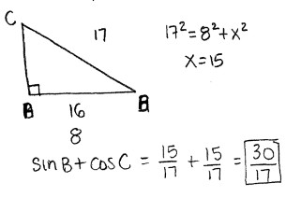

Slide 18
If the point (5,-3) is on the terminal side
of $θ$, find the exact value (no decimals) of
six trig functions.

Slide 19
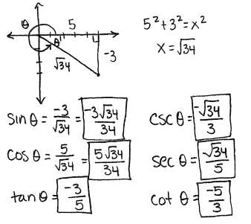

Slide 20
Find the quadrant: $\cos{θ}<0,\tan{θ}>0$

Slide 22
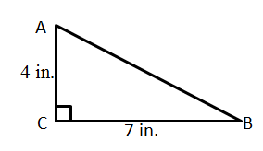
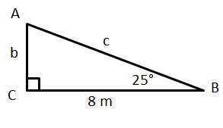
Solve the following right triangles.

Slide 23
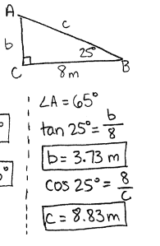
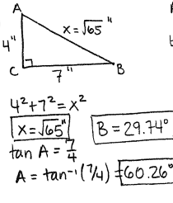

Slide 24
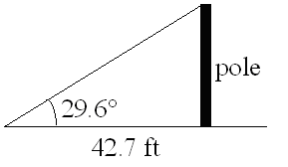
A support cable runs from the top of the telephone
pole to a point on the ground 42.7 feet from its base.
If the cable makes an angle of 29.6° with the
ground, find (rounding to the nearest tenth of a foot)
the height of the pole
the length of the cable
the height of the pole
the length of the cable

Slide 25
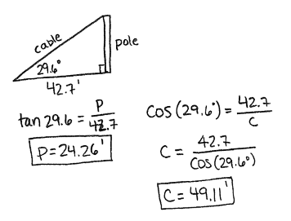

Slide 26
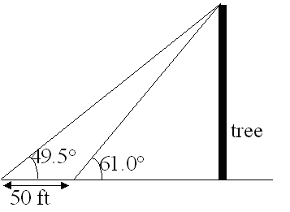
You are hiking along a river and see a tall tree on the
opposite bank. You measure the angle of elevation
of the top of the tree and find it to be 61.0°. You
then walk 50 feet directly away from the tree and
measure the angle of elevation. If the second
measurement is 49.5°, how tall is the tree?
Round your answer to the nearest foot.

Slide 27
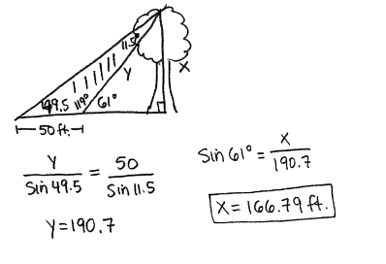

Slide 28
Jordan can spin a basketball on his finger
at 40 rpm. If the radius is 4.7 inches, find
the velocity in miles per hour.

