Slide 1
Precalculus
Sections 1.1-1.3 Review

Slide 2
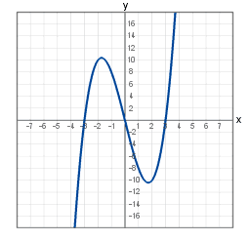
Is the graph pictured below a function?

Slide 3
Find the equation for the line through the points (-2,5) and (3,2).

Slide 4
Find the equation for the vertical line through the point (-5,-1).

Slide 5
Write an equation for the line perpendicular
to $3x−6y=5$ that passes through the
point $\left(2,−8\right)$.

Slide 6
Biologists have observed that the chirping rate of crickets of a certain species is related to temperature, and the relationship appears to be very nearly linear. A cricket produces 120 chirps per minute at 70$℉$ and 168 chirps per minute at 80$℉$. Find the linear equation that gives temperature t in terms of the number of chirps n.

Slide 7
For the function f given by
$$f\left(x\right)=6x^{2}+3x−5$$
find $f\left(−2\right)$.

Slide 8
Give the domain for the function
$$f\left(x\right)=6x^{2}+3x−5$$

Slide 9
Give the domain for the following function:
$$f\left(x\right)=\frac{7x+2}{3x−8}$$

Slide 10
Give the domain of the following function:
$$g\left(x\right)=\sqrt{2x−1}$$

Slide 11
Evaluate the difference quotient $\frac{f\left(x+h\right)−f\left(x\right)}{h}$
for the function $f\left(x\right)=5x^{2}−4x+1$.

Slide 12
Find the maximum and the minimum.

Slide 13
Find the intervals of increase and decrease.

Slide 14
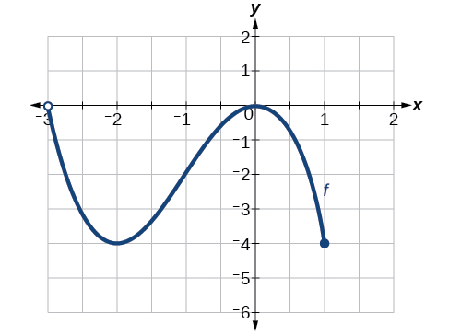
Find the domain and range of the
given graph:

Slide 15
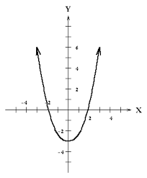
Find the domain and range of the
given graph.

Slide 16
Find the minimum for the function
$$f\left(x\right)=5x^{2}+8x−2$$

